Slide 1
20XX-XX
BENEFITS OPEN ENROLLMENT
November 15 - 29

Slide 2
20XX-XX
Benefits
Open Enrollment
November 15 - 29
Your Health l Your Family l Your Life

Slide 3
20XX-XX
OPEN ENROLLMENT BENEFITS
November 15 - 29

Slide 4
20XX-XX
Benefits Open Enrollment
November 15 - 29

Slide 5
20XX-XX
benefits
open enrollment
November 15 - 29

Slide 6
20xx-xx
Benefits
Open Enrollment
November 15 - 29

Slide 7
20XX-XX
Open
Benefits
Enrollment
November 15 - 29

Slide 8
20XX-XX
Open
Enrollment
November 15 - 29

Slide 9
Benefits
20XX-XX
Open
Enrollment
November 15 – 29

Slide 10
20XX-20XX
Benefits
open enrollment
NOVEMBER 15 - 29
Health ● Financial ● Work-Life

Slide 11
YOUR
20XX-XX
BENEFITS
^{November 15 - 29}

Slide 12
Open Enrollment
20XX
Benefits
IT’S TIME FOR
November 15 - 29

Slide 13
Benefits Open Enrollment
20XX
November 15 - 29

Slide 14
2022-2023
Benefits
Open
Enrollment
November 15 - 29

Slide 15
YOUR
20XX-XX
BENEFITS
November 15 - 29
^{November 15 - 29}

Slide 16
20XX-20XX
BENEFITS
OPEN
ENROLLMENT
November 15 - 29

Slide 17
20XX-20XX
BENEFITS OPEN
ENROLLMENT
^{November 15 - 29}

Slide 18
BENEFITS
YOUR 20XX-20XX
Open Enrollment
^{November 15 - 29}

Slide 19
20XX-20XX
BENEFITS
OPEN
ENROLLMENT
^{November 15 - 29}

Slide 20
^{Health}
^{Financial}
^{Work-Life}
20XX – XX
BENEFITS
OPEN ENROLLMENT
November 15 - 29

Slide 21
Benefits
Open
Enrollment
20XX-20XX
^{November 15 - 29}

Slide 22
²⁰²²⁻²⁰²³
^{Benefits}
Open Enrollment
^{November 15 - 29}

Slide 23
20XX – XX
BENEFITS
OPEN ENROLLMENT
^{Health}
^{Financial}
^{Work-Life}
November 15 - 29

Slide 24
Benefits
Open
Enrollment
^{November 15 - 29}

Slide 25
20XX – 20XX
BENEFITS
OPEN ENROLLMENT
November 15 - 29

Slide 26
20XX – 20XX
Benefits
Open Enrollment
November 15 - 29

Slide 27
20XX – 20XX
BENEFITS
OPEN ENROLLMENT
November 15 - 29

Slide 28
Benefits
^{20XX} ⁻
^{20XX}
Open Enrollment
November 15 - 29

Slide 29
BENEFITS
Open Enrollment
November 15 - 29

Slide 30
20XX-XX
BENEFIT
OPEN ENROLLMENT
November 15 - 29

Slide 31
20XX-XX
November 15 - 29
BENEFITS OPEN ENROLLMENT

Slide 32
20XX
BENEFITS
OPEN
ENROLLMENT
BENEFITS
OPEN
ENROLLMENT
November 15 - 29

Slide 33
Open Enrollment
20XX-20XX
November 15 - 29

Slide 34
20XX-20XX
OPEN
ENROLLMENT
November 15 - 29

Slide 35
^{November 15 - 29}
BENEFITS GUIDE

Slide 36
Open Enrollment
20XX
Designed for you!
NOVEMBER 15 - 29
Helping protect the things that matter most

Slide 37
20XX –
20XX
Open
Enrollment
my life | my health | my family
November 15 - 29

Slide 38
20XX-20XX
OPENENROLLMENT
NOV. 15 - 29

Slide 39
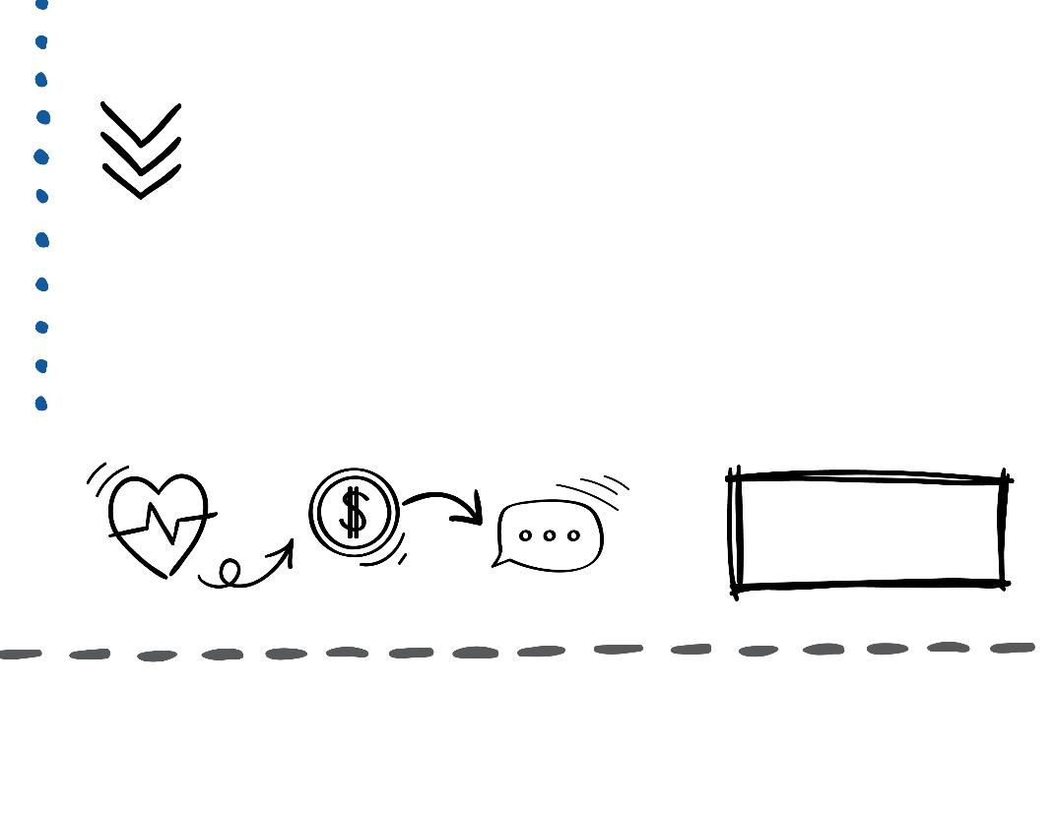
20XX- 20XX
Open Enrollment
November 15 - 29

Slide 40
BENEFITS
OPEN
ENROLLMENT
20XX-20XX
November 15 - 29

Slide 41
20XX
Benefits Open Enrollment
NOV. 15 - 29
Health
Financial
Work-Life

Slide 42
^{HEALTH}
^{WELLNESS}
^{FINANCIAL}
20XX
OPEN ENROLLMENT
Nov. 15 - 29

Slide 43
20XX
OPEN ENROLLMENT
Nov. 15 – 29

Slide 44
20XX Benefits
Open Enrollment
NOV. 15 - 29
Health Financial Work-Life

Slide 45
20XX-XX
Open Enrollment
^{Health}
^{Financial}
^{Work-Life}
NOV. 15 - 29

Slide 46
20XX Benefits
Open Enrollment
NOV. 15 - 29

Slide 47
20XX – 20XX
Open Enrollment
my life | my health | my family
November 15 - 29

Slide 48
201X
OPEN ENROLLMENT
Nov. 15 - 29

Slide 49
20XX
NOV. 15 – 29
OPEN
ENROLLMENT
Your Health
Your Family
Your Life

Slide 50
^{Your HEALTH}
^{Your FAMILY}
^{Your LIFE}
20XX BENEFITS OPEN ENROLLMENT
November 15 - 29

Slide 51
20XX
Your Health
Your Family
Your Life
OPEN ENROLLMENT
Nov. 15 - 29

Slide 52
20XX BENEFITS OPEN ENROLLMENT
November 15 - 29
You Journey to Wellness Begins Here!

Slide 53
20XX -20XX Open Enrollment
November 15 - 29
^{HEALTH}
^{WELLNESS}
^{FINANCIAL}

Slide 56
Open Enrollment
20XX BENEFITS

Slide 57
20XX Open Enrollment

Slide 58
20XX Benefits Open Enrollment NOV. 15 - 29

Slide 59
It’s Time for 20XX Benefits Open Enrollment NOVEMBER 15 - 29

Slide 60
OPEN ENROLLMENT
20XX -20XX
November 15 - 29
^{Your HEALTH}
^{Your FAMILY}
^{Your LIFE}

Slide 61
20XX- 20XX
Open Enrollment
November 15 - 29
^{Your Health}
^{Your Family}
^{Your Life}

Slide 62
20XX
20XX
^{Your Health}
^{Your Family}
^{Your Life}
20XX Benefits Open Enrollment
NOV. 15 - 29

Slide 63
20XX – 20XX Open Enrollment
Your Health | Your Family | Your Life
November 15 - 29

Slide 64
20XX Benefits Open Enrollment NOV. 15 - 29
Your Health | Your Family | Your Life

Slide 65
November 15 - 29
^{Your Health}
^{Your Family}
^{Your Life}
20XX – 20XX Open Enrollment

Slide 66
Your Health | Your Family | Your Life
20XX-XX Benefits Open Enrollment
November 15 - 29

Slide 67
Your Health Your Family Your Life
Open Enrollment
20XX-XX Benefits
November 15 - 29

Slide 68
It’s Time for 20XX BENEFITS Open Enrollment NOV. 15 - 29
YOUR HEALTH | YOUR FAMILY | YOUR LIFE

