Slide 2
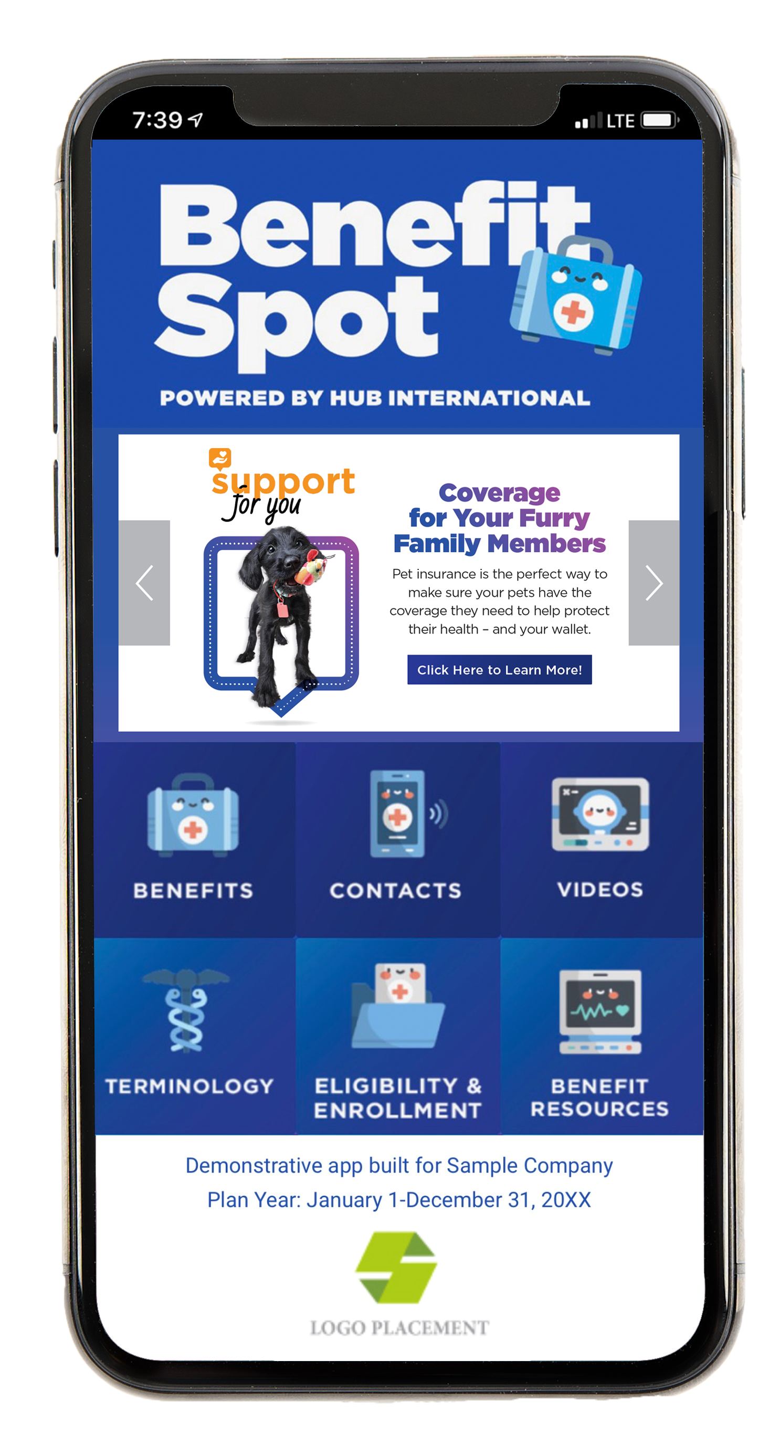
HUB Benefit Spot Key Features & Capabilities
Choose six OR nine home page buttons
A selection of QEX/Made For You banners to highlight their personalized benefits
Unique company code employees can enter to access your company's benefits information
Compatible with Apple and Android devices
Links to benefit resources (e.g., Benefit Guide, SPDs, SBCs, etc.)
Links to cost comparison tools and carrier contact information
“Tap to call” function
And more!
  

Slide 3
Home Page Button Options
BENEFITS
Benefit plan overviews
CONTACTS
Carrier names, phone numbers and websites/emails
VIDEOS
Library of educational videos
TERMINOLOGY
Glossary of common benefit terms
ELIGIBILITY & ENROLLMENT
Details on who can enroll
and how to enroll
BENEFIT RESOURCES
Additional documents such as benefits guide, SPDs, etc.
RX PRICING
Link to www.GoodRx.com
MEDICAL PRICING
Link to your client’s cost comparison tool
TELEHEALTH
Link to your client’s telehealth provider website
EAP
Link to your client’s Employee Assistance Program website
RETIREMENT
Intended for HUB Advised Retirement Plans Only. Links to retirement administrator website.
VB RESOURCES
Additional documents relating to Voluntary Benefits
CALL HR / SERVICE CENTER*
Tap to call resource for questions
*Button will display either HR or Service Center depending on the preferred contact
EMPLOYEE
DISCOUNTS
Link to your client’s Employee Discount portal
WELLNESS
Wellness newsletters or details about your client’s wellness program

Slide 4
Why HUB Benefit Spot?
80%
of workers are deskless
Source: Google estimates
31%
of employees never use company intranet
Source: Prescient Digital Media
6 hours
is the amount of time an average person spends per day on digital media
Source: “Tech Addiction By the Numbers: How Much Time We Spend Online”, PC Magazine

Slide 5
Check It Out!
Want To Know More?
Click here to watch a short video about Benefit Spot.
Try Benefit Spot today!
To explore the app yourself, simply search “Benefit Spot” in the Apple App Store or Google Play on your mobile device. Download the app and enter company code HUB. NOTE: The company code is case sensitive.

Slide 6
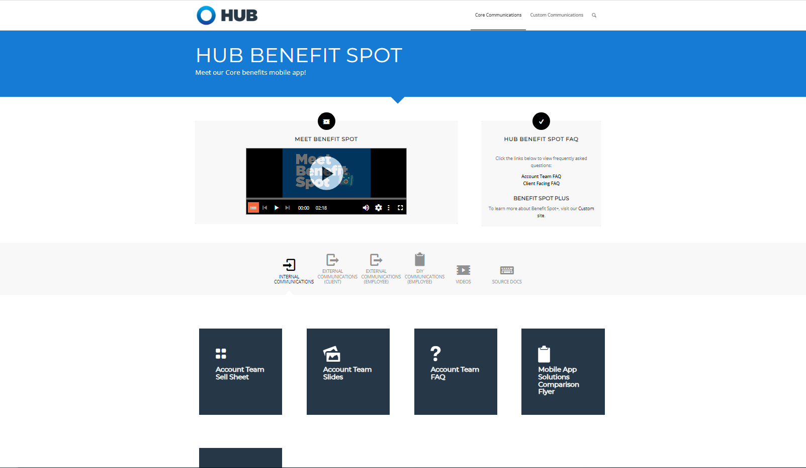
Where Do We Go From Here?
Place your order at orderhubcd.com/core/benefitspot
Easy online ordering process
Available for 2 credits or $1,200
15 business days for initial setup, testing and approval
A list of Frequently Asked Questions is available on OrderHUBCD

Slide 7
?
If you have questions or are interested in HUB Benefit Spot for your client, go to orderhubcd.com or email benefitspot@hubinternational.com

