Slide 1
A LIBRARY OF COVERS CAN BE FOUND AT
https://www.orderhubcd.com/core/diy-templates/#presentations

Slide 2
AGENDA
Welcome
What’s New
What’s Changing
Eligibility & Enrollment
Review of 20XX Benefits
How to Enroll
Questions

Slide 3
WHAT’S NEW
MEDICAL
New Plan Option
Lower rates
Higher deductible
DENTAL
New Plan Option
Lower rates
Higher deductible

Slide 4
WHAT’S CHANGING
MEDICAL
HMO Plan
Insert Change
Insert Change
MEDICAL
PPO Plan
Insert Change
Insert Change

Slide 5
ELIGIBILITY
Who can enroll?
Employees working at least 30 hours/week
Legal spouse or registered domestic partner
Children under the age of 26
When can you enroll?
Within 60 days of your date of hire
During annual open enrollment
Within 31 days of a Qualifying Event

Slide 6
MEDICAL COVERAGE

Slide 7
MEDICAL PLAN COMPARISON
Key Medical Benefits | Carrier Plan 1 | Carrier Plan 2 |  | Carrier Plan 3
 | In-Network Only | In-Network | Out-of-Network | In-Network | Out-of-Network
Deductible (Individual/Family)
Out-of-Pocket Maximum (Individual/Family)
Covered Services
Office Visit (Physician/Specialist)
Routine Preventive Care
Outpatient Diagnostic Lab/X-ray
Outpatient Surgery
Inpatient Hospital Stay
Emergency Room
Urgent Care Facility
Prescription Drugs (Tier 1/Tier 2/Tier 3)
Retail Pharmacy (30-day supply)
Mail Order (90-day supply)

Slide 8
DENTAL COVERAGE

Slide 9
DENTAL PLAN COMPARISON
Key Dental Benefits | Carrier Plan 1 | Carrier Plan 2
 | In-Network Only | In-Network | Out-of-Network
Deductible (Individual/Family)
Benefit Maximum (per Individual)
Covered Services
Preventive Services (List Services)
Basic Services (List Services)
Major Services (List Services)
Orthodontia (Adults & Children)

Slide 10
VISION COVERAGE

Slide 11
VISION PLAN HIGHLIGHTS
Key Vision Benefits | Carrier Plan 1
 | In-Network Only | Out-of-Network
Exam (once every 12 months)
Lenses (once every 12 months)
Single Vision
Bifocal
Trifocal
Lenticular
Frames (once every 24 months)
Contact Lenses (once every 12 months; instead of prescription glasses)

Slide 12
LIFE/AD&D INSURANCE

Slide 13
BASIC LIFE / AD&D
100% paid by The Company
Provided through (carrier)
Insert benefit amount
Designate or update your beneficiary information

Slide 14
SUPPLEMENTAL LIFE / AD&D
100% paid by The Company
Provided through (carrier)
Evidence of Insurability
Details for OE
Benefit Options
Employee
Spouse
Child(ren)

Slide 15
DISABILITY INSURANCE

Slide 16
DISABILITY
Short Term Disability
Long Term Disability
100% paid by The Company
Provided through (carrier)
100% paid by The Company
Provided through (carrier)
Plan Highlights
Benefit Percentage
Weekly Benefit Maximum
When Benefits Begin
Maximum Benefit Duration
Plan Highlights
Benefit Percentage
Monthly Benefit Maximum
When Benefits Begin
Maximum Benefit Duration

Slide 17
EMPLOYEE ASSISTANCE PROGRAM

Slide 18
EMPLOYEE ASSISTANCE PROGRAM
100% paid by The Company
Provided through (carrier)
Counseling on Personal Issues, such as:
Stress, anxiety, depression
Relationships
Problems with your children
Substance abuse
EAP Services
Assistance for you or a household family member
Up to three (3) in-person sessions with a counselor, per year, per individual
Unlimited toll-free phone access 24/7
Online resources 24/7
Work/life services for assistance with child care, elder care, financial issues, plus much more

Slide 19
FLEXIBLE SPENDING ACCOUNTS

Slide 20
FLEXIBLE SPENDING ACCOUNTS (FSA)
Set aside a portion of your income, before taxes, to pay for qualified health care and/or dependent care expenses
Decrease your taxable income and increase your take-home pay
Health Care FSA
$2,550 maximum annual contribution
Eligible expenses include:
Coinsurance
Copays
Deductibles
Dental treatment
Vision care
Prescriptions

Slide 21
FLEXIBLE SPENDING ACCOUNTS (FSA)
Dependent Care FSA
$5,000 maximum annual contribution (per family)
Eligible expenses include:
Care of a dependent child under the age of 13 by babysitters, nursery schools, pre-school or daycare centers.
Care of a household member who is physically or mentally incapable of caring for him/herself and qualifies as your federal tax dependent.
Important FSA Rules
Unused health care funds over $500 will NOT be returned to you or carried over to the following year.
Unused dependent care funds will NOT be returned to you or carried over to the following year.

Slide 22
VOLUNTARY BENEFITS

Slide 23
VOLUNTARY BENEFITS
Designed to complement your health care coverage.
Completely Voluntary. You are responsible for paying for coverage at affordable group rates.
Coverage also available for your spouse and dependents.
Accident Insurance
Accident insurance can soften the financial impact of an accidental injury by paying a benefit to you to help cover the unexpected out-of-pocket costs related to treating your injuries.
Critical Illness
Did you know that the average total out-of-pocket cost related to treating a critical illness is over $7,000¹? With critical illness insurance, you’ll receive a lump-sum benefit if you are diagnosed with a covered condition that you can use however you would like, including to help pay for: treatment (e.g. experimental), prescriptions, travel, increased living expenses, and more.
Hospital Indemnity Insurance
The average cost of a hospital stay is $10,000²—and the average length of a stay is 4.8 days³. Hospital indemnity insurance can help reduce costs by paying you or a covered dependent a benefit to help cover your deductible, coinsurance and other out-of-pocket costs due to a covered sickness or injury related hospitalization.
MetLife Accident and Critical Illness Impact Study, October 2013
Costs for Hospital Stays in the United States, 2011. HCUP Statistical Brief #168. December 2013. Agency for Healthcare Research and Quality, Rockville, MD.
National Hospital Discharge Survey: 2010

Slide 24
VALUABLE EXTRAS

Slide 25
VALUABLE EXTRAS
Extra 1
Extra 2
Extra 3
Extra 4
Extra 5
Extra 6

Slide 26
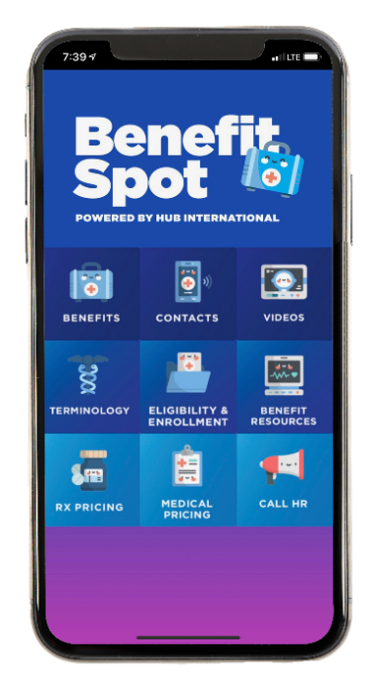
MEET BENEFIT SPOT
We’ve Gone Mobile!
Downloading Is Easy!
With Benefit Spot you can access company benefit information 24/7 - even when you’re away from work and need it most!
You’ll be able to:
Access benefit plan information
Watch educational videos
Look up carrier contact information
And more!
Simply go to the Apple App Store or Google Play on your device.
Download the “Benefit Spot” app
Whenever your launch the app, enter company code ABC123 to access our plan information. NOTE: The company code is case sensitive.

Slide 27
BENEFIT COSTS

Slide 28
BENEFIT COSTS (BIWEEKLY)
Coverage Tier | MEDICAL
 | Plan 1 | Plan 2 | Plan 3
Employee Only
Employee + Spouse
Employee + Child(ren)
Employee + Family
Coverage Tier | DENTAL
 | Plan 1 | Plan 2
Employee Only
Employee + Spouse
Employee + Child(ren)
Employee + Family
Coverage Tier | VISION
 | Plan 1
Employee Only
Employee + Spouse
Employee + Child(ren)
Employee + Family

Slide 29
How to enroll
www.WebsiteAddress.com
Deadline is Friday, November 17, 20XX

Slide 30
QUESTIONS

