Slide 1
What Is An HDHP HSA?
High Deductible
Health Plan (HDHP)
+
Health Savings Account (HSA)
=
CARRIER HDHP
HSA Plan
PPO medical plan
Freedom to seek care from the provider of your choice
You pay the full cost of your medical and prescription drug expenses up to the calendar year deductible amount, before the plan starts to pay
After you meet the deductible, the plan shares the cost of eligible expenses. This can be paid for from your HSA as long as there’s money in the account.
Personal savings account that allows you to save and pay for qualified health related expenses on a pre-tax basis.
ABC Company contributes to your account.
$500/employee only coverage
$1,000 employee plus dependent(s)
You also have the ability to contribute through payroll deductions up to annual IRS maximums
Contributions, interest earnings and withdrawals for qualified health expenses are excluded from Federal income tax

Slide 2
How the HDHP HSA Works
You can use the money in your HSA for your share of expenses at any time
You pay 100% of
health care costs
You pay 10% or 20%
The plan pays 90% or 80%
Relax!
The plan pays 100%
Preventive care is free!
ABC Company’s contributions to the HSA help offset your deductible

Slide 3
HSA Features
HSAs Fund Health Care Needs
The HSA fund can be used for future medical needs and toward the plan’s annual deductible and out-of-pocket maximum.
HSAs are Flexible
You decide when to use your HSA funds to pay for qualified health related expenses. The HSA moves with you when you change medical plans, change employers or retire.
HSAs Can Cover You in Retirement
Your HSA funds can be used in retirement for eligible health related expenses, including Medicare expenses.
No “use it or lose it!”
That’s right, unused funds roll over each year. Unused funds can also grow through interest and investment earnings and can be “banked” for future health related expenses.
Triple Tax-Advantaged (for federal & most state taxes)
No tax on contributions
No tax on interest
No tax when you withdraw money

Slide 4
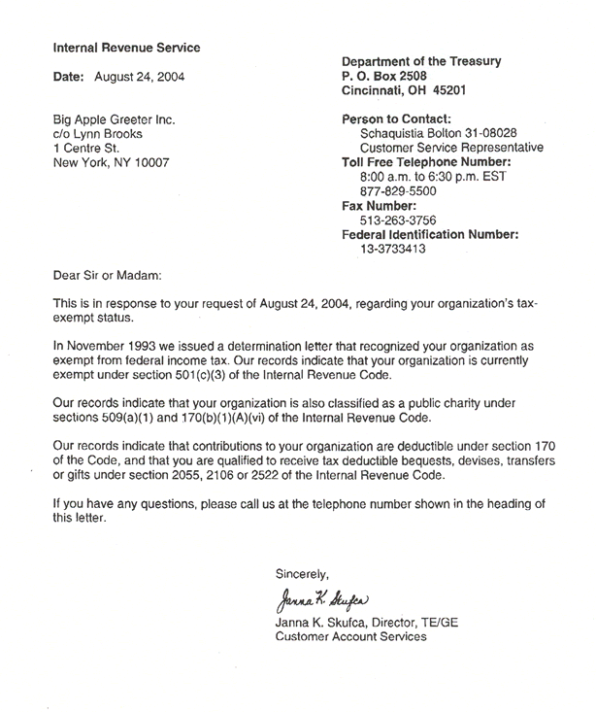
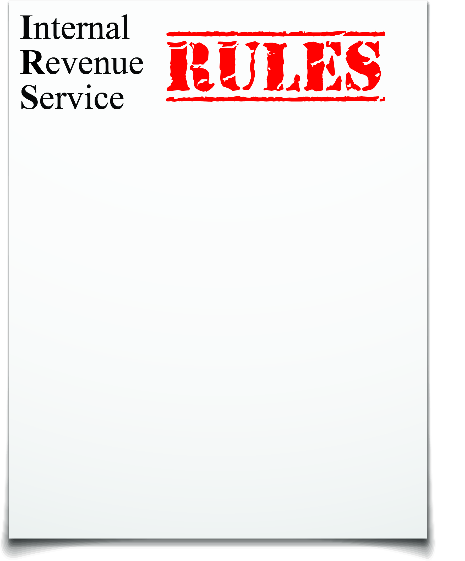
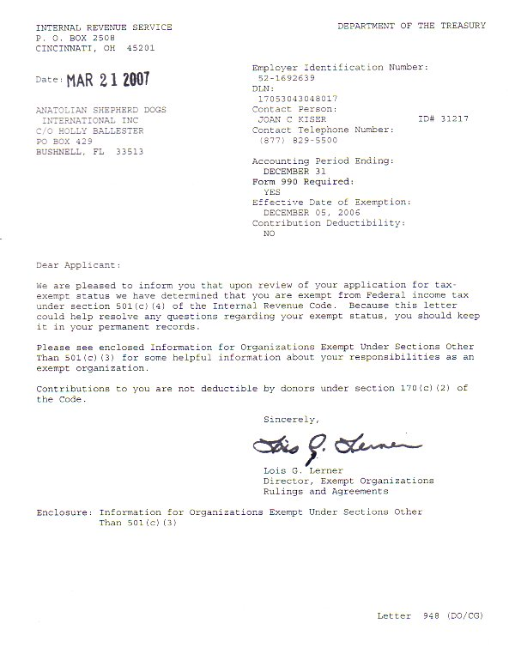
IRS Maximums
HSA Contribution Regulations
Coverage Type | 2015 Annual Limit
Employee Only | $3,350
Employee + Dependent(s) | $6,650
Catch-Up Plan (must be 55-65 years old) | extra $1,000
Notes:
The IRS sets some limits on your pre-tax contributions, so you can’t contribute more than the annual limits listed here. You’ll also see that if you are between age 55 and 65, the IRS lets you take advantage of a special “catch-up” provision and make some larger contributions. These limits are evaluated and set each year.

Slide 5
Who is eligible to participate?
Per IRS, individuals are qualified for an HSA if they are:
Covered by an HSA compatible high deductible health plan
Not covered by any other health plan
Not claimed as a dependent on another person’s tax return (excluding spouses per Internal Revenue Code)
Not enrolled in Medicare or a Tricare program

